Slide 1
Michigan’s Iron Belle Trail
Crawford County

Slide 2
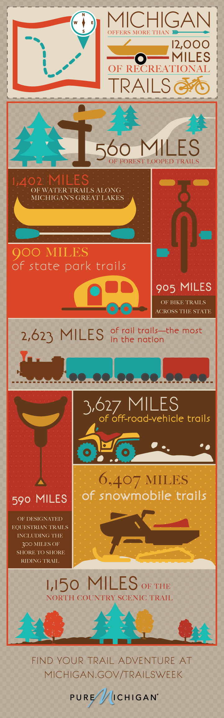
National Leader in Trails

Slide 3
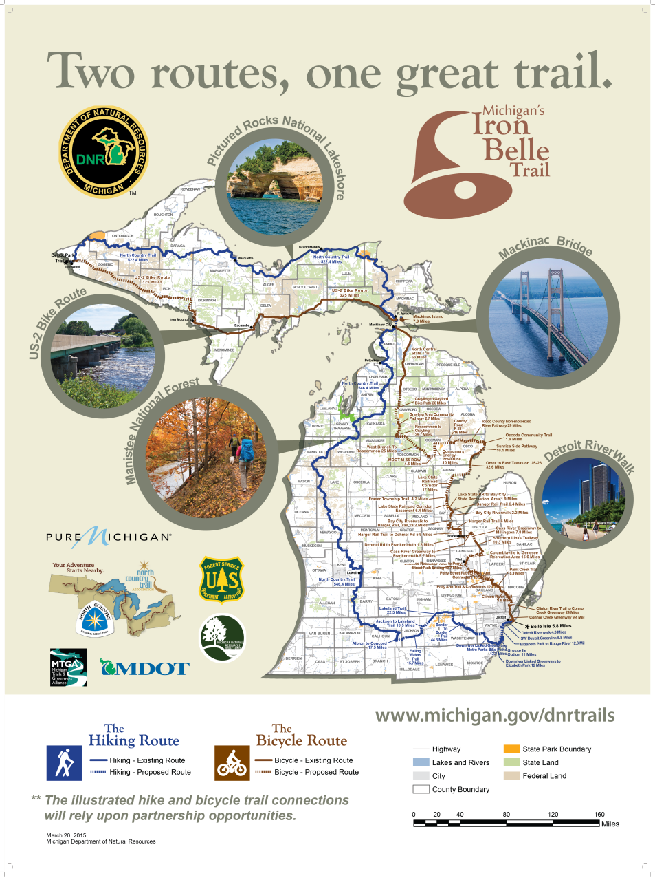
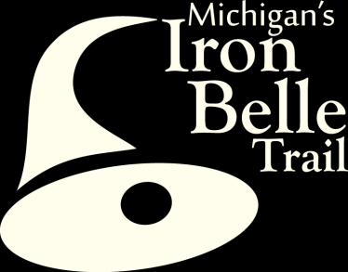

Slide 4
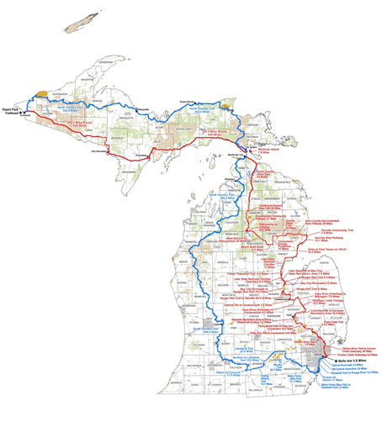
Iron Belle Trail
Two Routes, one great trail
Longest State-designated trail in the nation (2,064 mi)
  48 Counties
  240 Townships
  83 Towns/villages
Links numerous existing trails
Provides recreation, transportation and economic opportunities
Hike it
Bike it
www.michigan.gov/dnrtrails

Slide 5
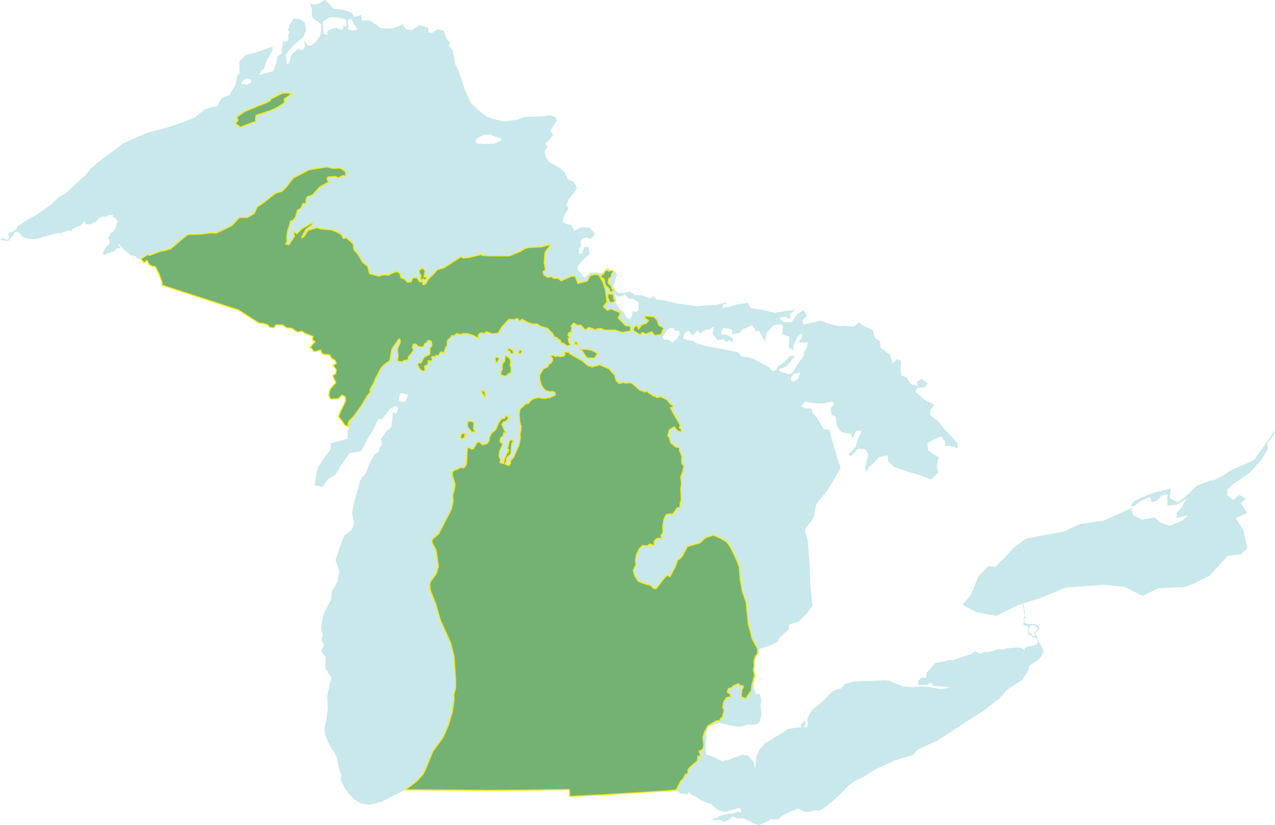
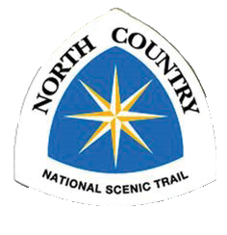
The Hiking Route
Follows the North Country National Scenic Trail, starting in Bridges Park, Calhoun County
Traverses the west side of Lower Peninsula
Borders Lake Superior in the Upper Peninsula
1,273 miles
70% Existing trails
30% to be developed
www.michigan.gov/dnrtrails

Slide 6
Biking Route
Uses existing multi-use trails
Follows US-2 (federal bike route 10 in the U.P.)
791 miles
64% completed
36% to be developed
www.michigan.gov/dnrtrails

Slide 7
How is it going to happen?
State wide vision
Locally implemented with DNR support:
  Regional IBT facilitators (NEMCOG)
  Identifying regional priorities
  DNR IBT grant funding available for route planning
  Grant writing and Fundraising
  Public exposure / Marketing

Slide 8
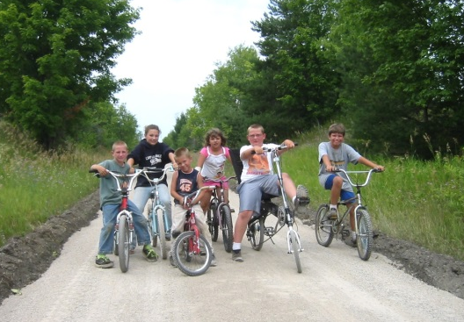
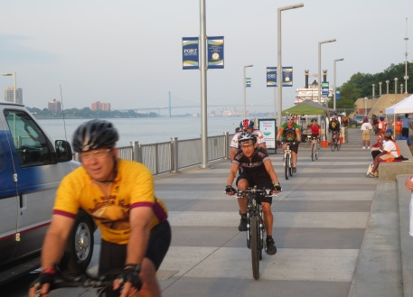
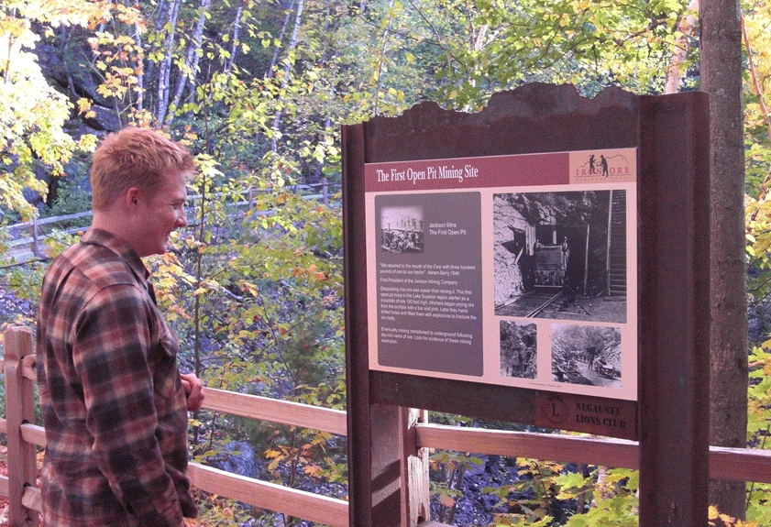
Challenges
Secure land by license, easement or purchase for public rec. use
Capacity – use local partners
Secure and coordinate multiple funding sources
Consistency of experience
  Maintenance
  Signage
  Bicycling facilities – goal is to have separate path, off of the road; minimize driveway crossings and trail/road crossings on roads when possible

Slide 9
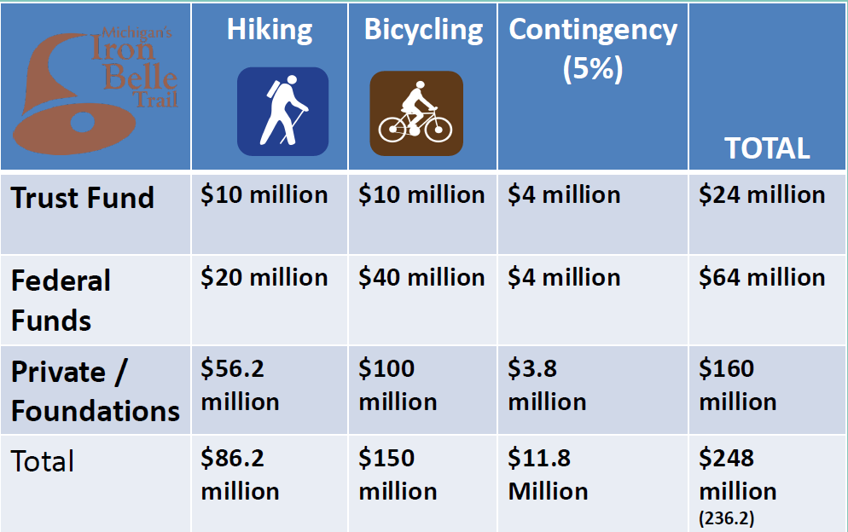
Funding Strategy
Notes:
IBT Campaign underway: established non-profit entity with MI Fitness Fdtn. Serving as fiduciary to raise $160 million in private funding.

Slide 10
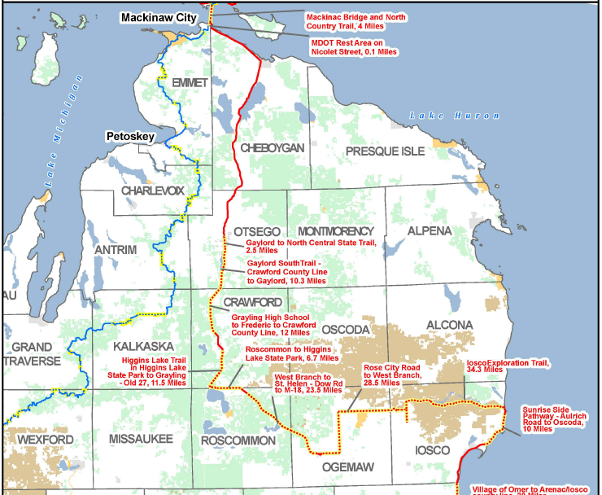
Trail Gaps in the Route
Northern Lower Peninsula
Notes:
Preliminary route, based on information in the 2009 NEMI No-Mo Transportation Plan.
Follow road rights-of-way, utility corridors, active rail corridors. Can have on-road facilities (widened shoulders or bike lanes), but strong preference for bicycle paths separate from the road. Surface could be crushed limestone or asphalt (nicer user experience, but more expensive to build and maintain).
Just over 22 miles of the trail through Roscommon County

Slide 11
Crawford County
Route Planning as of Jan 2017
~30 + mile Bicycling Route portion of the IBT through Crawford County to connect North Higgins Lake State Park, City of Grayling, Hartwick Pines State Park, & Otsego Lake State Park.
Crawford County Road Commission received an Iron Belle Planning Grant in 2015 to fund the preliminary planning and conceptual phasing of this trail; completed in December 2016.
IBT discussed at quarterly Crawford County Trails Committee meetings organized by Wayne Koppa

Slide 12
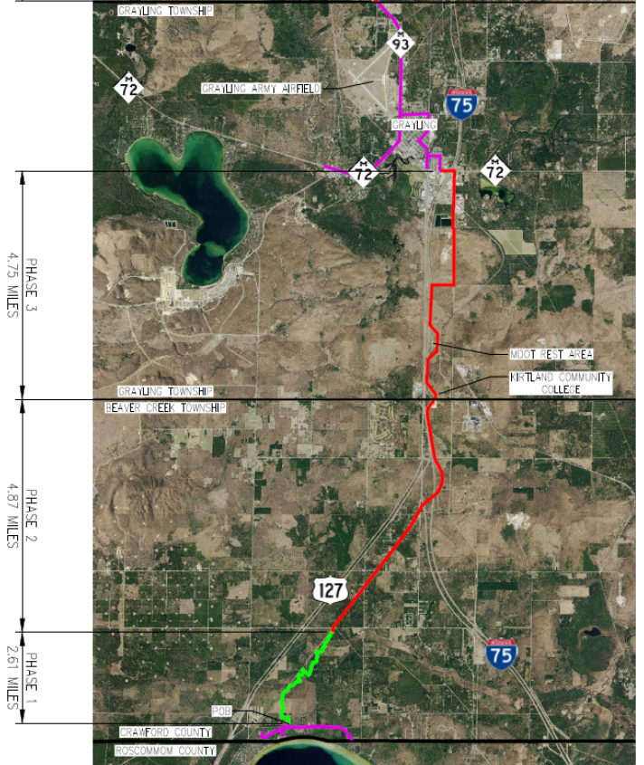
Crawford County
Proposed Route South of City
Phase 2, 4.87 mi. – Beaver Creek Twp: from 4 Mile Rd. to S Old 127 R.O.W. to Fletcher Rd. Est. $2 million total; $272,800 match (13.6%)
Phase 3, 4.75 mi. – end of City bike route to Industrial Drive, to Grayling Twp. easement leading to MDOT Rest Area and KCC. $1.96 million total cost; $250,400 match (12.8%)

Slide 13
Crawford County
Proposed Route Along Old 27 N -
Phase 4, 5.64 mi.– Frederic Twp.: from path ending at High School to Frederic, est. $2.7 million total cost; $571,400 match (21%)
Phase 5, 6.52 mi. - Frederic Twp/Maple Forest Twp: from Frederic to Cty Line, est. $2.46 million total cost; $467,400 match (19%)
Notes:
Northern end of trail in the county: follows south side of N. Roscommon Road/W. Federal Hwy. in Gerrish Twp.
Higgins Twp: Follows along active railroad and Old M-76 through Village of Roscommon. There iare approx. 1.5 miles of existing sidewalk in Village of Roscommon from Chevrolet dealership to just south of Fire Dept. building, but only 4’ or 6’ wide, and some areas need replacement.
Connections with North Higgins Lake State Park, KOA campgrounds on Federal Road, Wallace Park, Roscommon Metro Park and Tisdale Triangle trail system.

Slide 14
Crawford County
Next Steps
The City of Grayling applied for a $15,000 IBT grant in Jan. 2017 to fund a preliminary engineering study for the trail route along the railroad corridor through the City (in lieu of bike route), about 3 miles.

Slide 15
Crawford County
Next Steps
The Road Commission also applied for a $25,000 IBT grant (2017) to fund more detailed preliminary engineering and estimates needed for TAP and MNRTF grant applications to develop Phase III of the route (KCC to the City of Grayling).
This grant would also fund a Development and Funding Guide for Phases 2-5 of the route, which includes assistance to the communities in preparing grant applications to fund trail development.

Slide 16
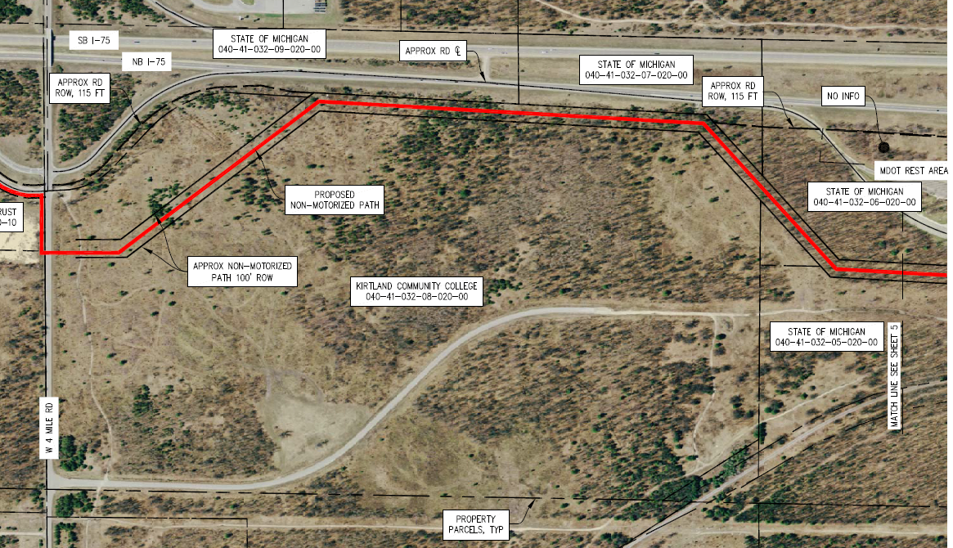
Crawford County
Phase III (Grayling Twp.)
→North
KCC

Slide 17
Crawford County
Phase III (Grayling Twp.)
→North
MDOT Rest Area

Slide 18
Crawford County
Phase III (Grayling Twp.)
→North

Slide 19
Crawford County
Phase III (Grayling Twp.)
Local Resolutions of Support needed in Feb 2017 for the IBT Grants
  Resolutions for both the City and RC grant applications
    City of Grayling (Feb 13)
    Grayling Twp (Feb 15)
  Resolutions for just the RC grant application
    Beaver Creek Twp (Feb 14)
    Frederic Twp (Feb 14)
    Maple Forest Twp (Feb 14)

Slide 20

Major Funding Source #1
Michigan Natural Resources Trust Fund
For land acquisition (no minimum request) or development (max $300,000) of lands to be open for public recreation
Only local units of government, school districts, or a local recreation authority with a current, approved MDNR 5-Year Recreation Plan on file may apply
Minimum 25% match
Due annually on April 1
Notes:
Often used to cover costs of surveying, design engineering and construction engineering.

Slide 21
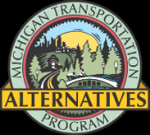
Major Funding Source #2
MDOT Transportation Alternatives Program (TAP) Grants
For construction of ped/bike facilities that are regional transportation connectors, and streetscape projects.
Eligible applicant could be the County Road Commission or DNR. MDOT may also partner with a local agency to apply for funding and implement the project.
Ideal 35-40% match; reimbursement program
Applications accepted year round
Notes:
Trust Fund grant monies can be used to help with the match for TAP grants, but still need to show some local matching funds. Does not cover survey, design engineering, & construction engineering (TF grant would cover this).
Otsego County (have a County Administrator) is working with their Townships along the trail route (follows active rail line/Old US-27) and DNR/DOT. The MDNR has a lease with the Lake State Railway for the land. 11 miles; crushed limestone; open to snowmobiles in winter. Est. construction cost: $2,340,000. County has been lead agency/grant applicant for the 11 mile south extension.
Crawford County RC applied for IBT grant for preliminary eng study of 30 mile route.
Otsego County took lead on their IBT grants.
Twps. Could apply for their own section of trail on for MNRTF or IBT grants; have agreement with RC to use ROW.

Slide 22
Other Funding Sources
For match $:
Local government funds (including adjacent communities)
Cash, labor or material donations
Grants that the MDNR can only apply for (Recreational Trails Program)
Private foundations
  i.e., DTE Energy, Consumers Energy, ITC $1K to $10K
  Most will only award to a 501(c)3 non-profit (need to establish?)
Consider creating a non-permanent account with North Central Michigan Community Foundation to receive funds

Slide 23
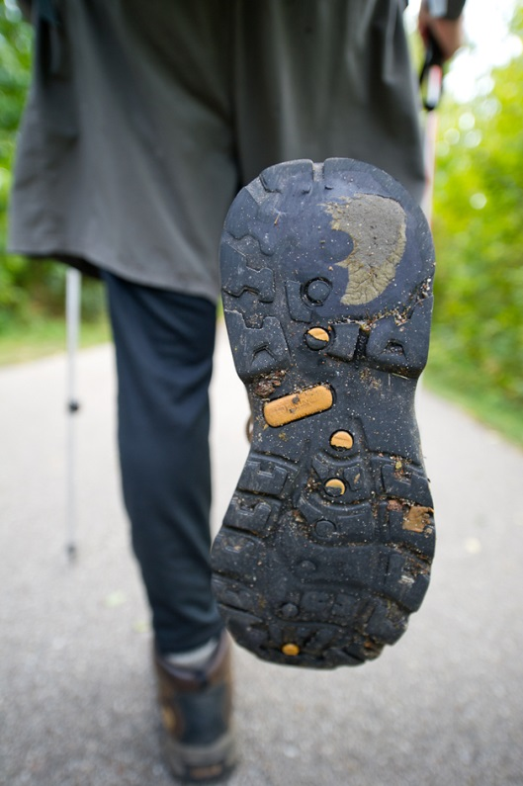
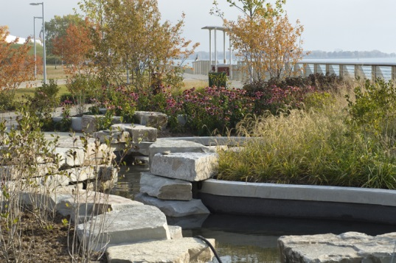
Trails are good for communities
Sense of place; people want to live near trails and in walkable communities
Increased land values
Healthy recreation and transportation options
Connected communities and community centers
Highlight local history and environment
Public exposure to stewardship
www.michigan.gov/dnrtrails

Slide 24
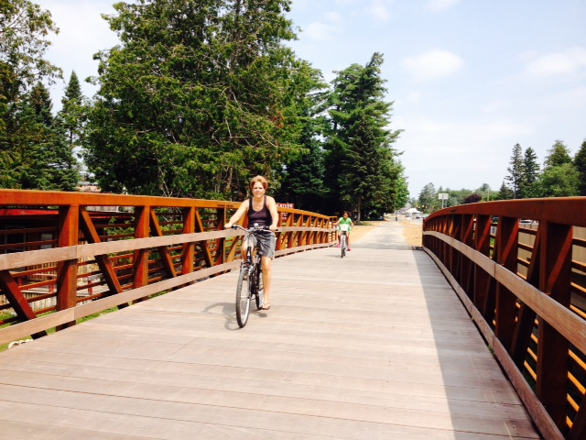
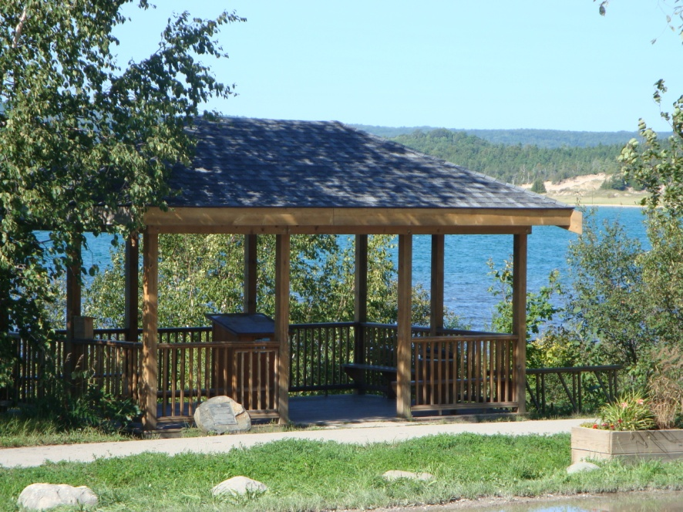
If you build it. . .
Communities invest locally with trail support facilities and trail connections to town.
Economic development follows
Locals take ownership
  Friends groups developed
  Local maintenance and policing
Non-motorized facilities become part of the transportation solution
Safe bike and pedestrian connections are found/developed

Slide 25
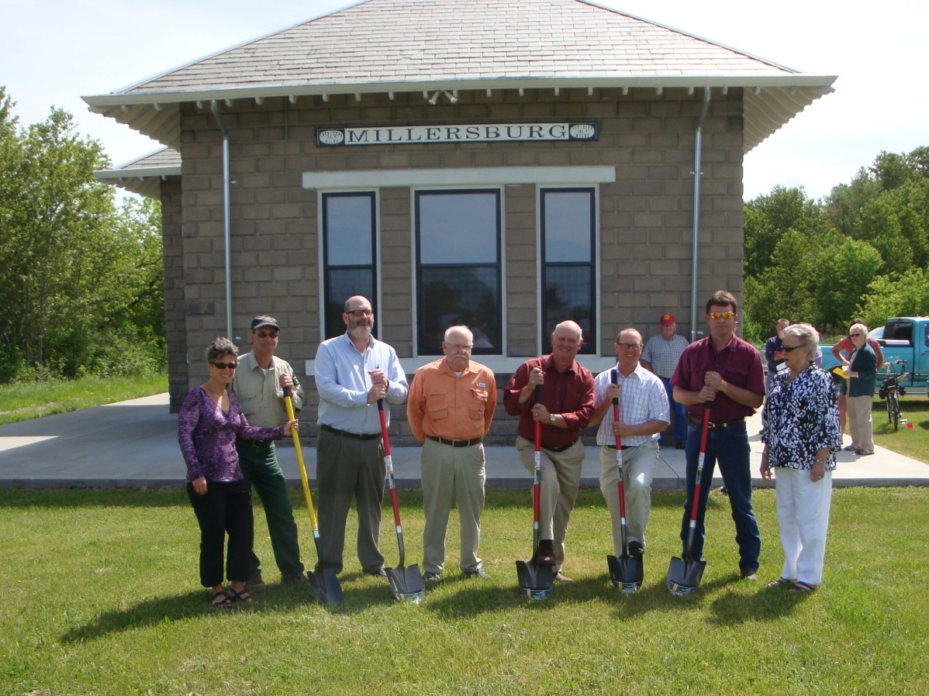
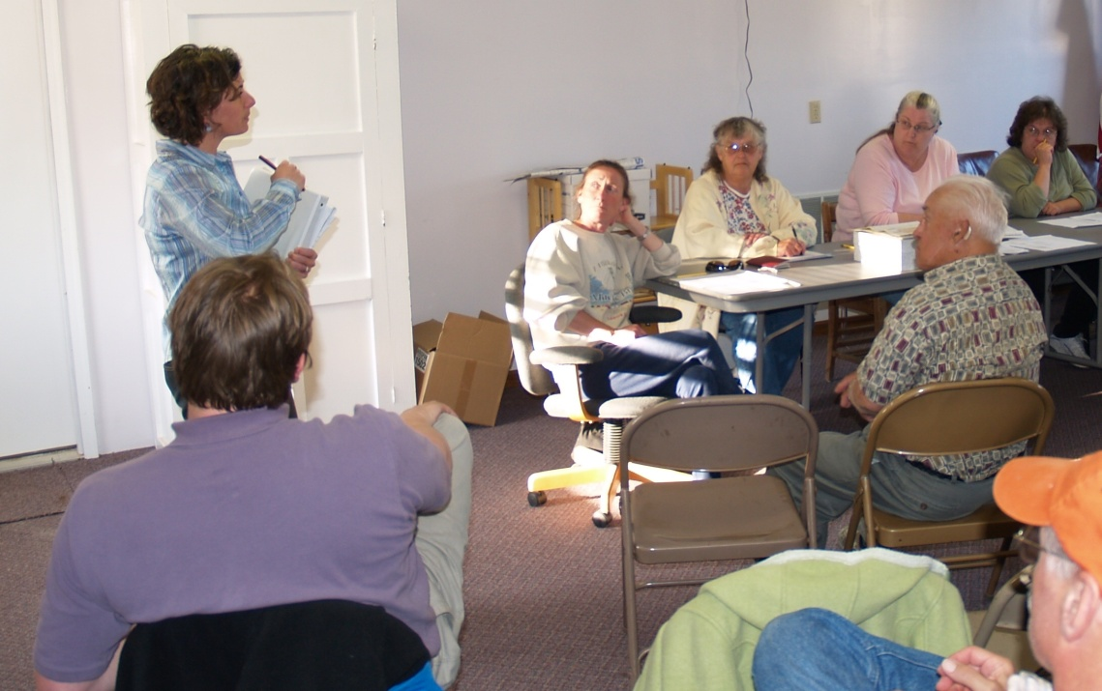
Understanding the benefits helps . . .
To find partners
To support your project
To gain consensus
To build your case
To find funding

Slide 26
Questions?
IBT Contracted Facilitator for Northeast MI:
Stephanie Loria, Associate Planner
Northeast MI Council of Governments (NEMCOG)
sloria@nemcog.org
989-705-3722
More information on Iron Belle Trail on DNR’s website: http://www.michigan.gov/dnr/0,4570,7-153-10365_16839_71459---,00.html

