Slide 1


Denise Cline
Putting the Pieces Together:
Michigan’s Proposed Housing Bills
Deputy Director
Northeast Michigan Housing Summit
April 30, 2026

Slide 2

The Housing Readiness Plan, introduced by a bipartisan group of legislators, is intended to increase the housing supply and decrease housing costs in Michigan.

Slide 3
Land Division Act
HB 5529
Section 109(1)(d) – “The ordinance shall not impose a minimum parcel size of more than 1,500 square feet for a detached single-family residence if the parcel is accessible to and will be served by public water and public sewer.”
Michigan Zoning Enabling Act
HB 5530
Section 205(f) – “A zoning ordinance must not impose a minimum parcel size of more than 1,500 square feet on land zoned for a detached single-family residence if the parcel is accessible to and will be served by public water and public sewer.”

Slide 4
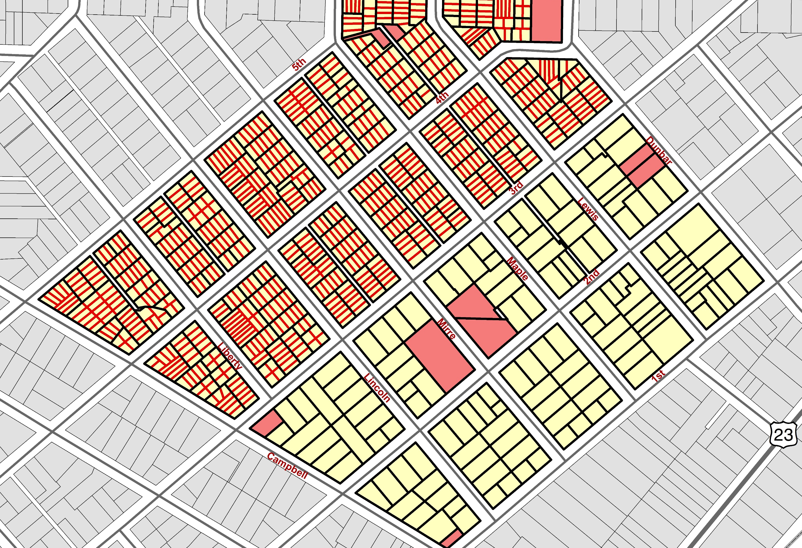

Slide 5
Michigan Zoning Enabling Act
Applies to all municipalities.
HB 5531
Section 501(3) –
Requires site plan to be submitted with a completed application form.
In reviewing site plan, local unit of government may require studies or other documents reasonably necessary to evaluate the site plan.
After initial site plan approval, local unit of government may require additional studies or documents to ensure compliance with standards in the ordinance or other laws or to address a public health and safety concern.
If applicant requests a change, local unit of government may require additional studies or documents to evaluate that change.

Slide 6

Michigan Zoning Enabling Act
Applies to all municipalities.
HB 5531
Section 501(5) – “Not more than 60 days after receipt of a site plan, a local unit of government shall approve, reject, or conditionally approve the site plan.”
How is “receipt of a site plan” defined? The amendment defines “initial site plan approval” only

Slide 7
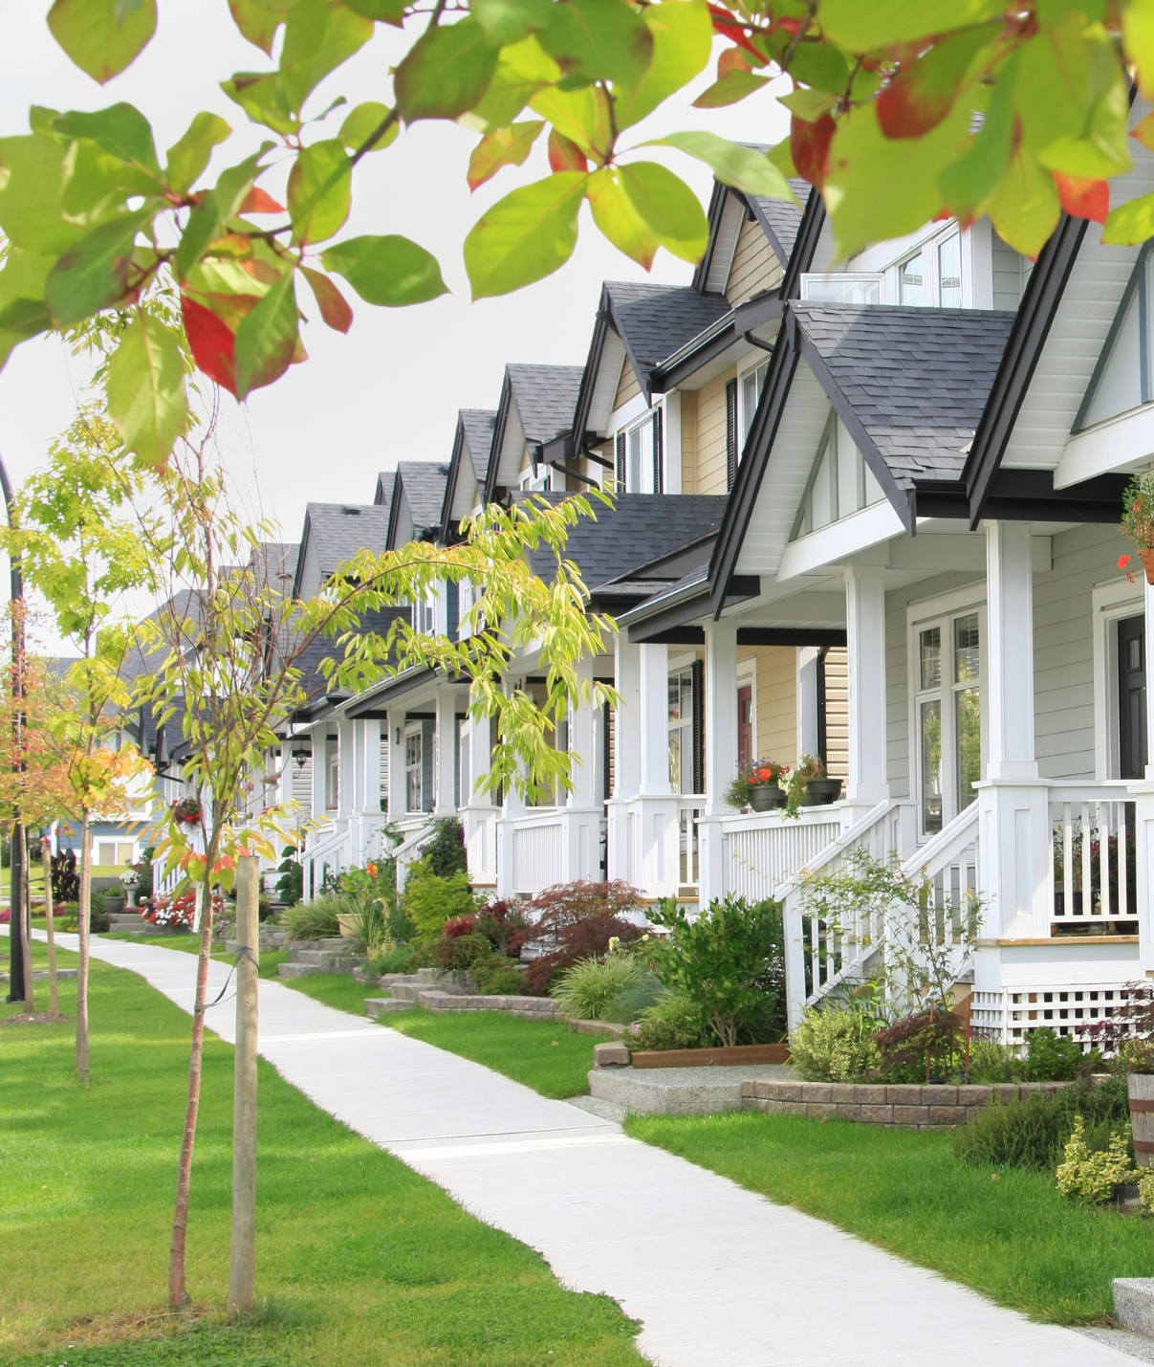
Michigan Zoning Enabling Act
Applies to cities and villages.
HB 5532
Section 403(4) – “If the amendment to the zoning ordinance increases the authorized number of dwelling units, the protest petition must be signed by at least one of the following: (b) The owners of at least 60% of the area of land included within an area extending outward 300 feet from any point on the boundary of the land included in the proposed change.”
Amendments are subject to protest petition in cities and villages – current law requires signatures of 20% of owners within the area of the proposed change.

Slide 8
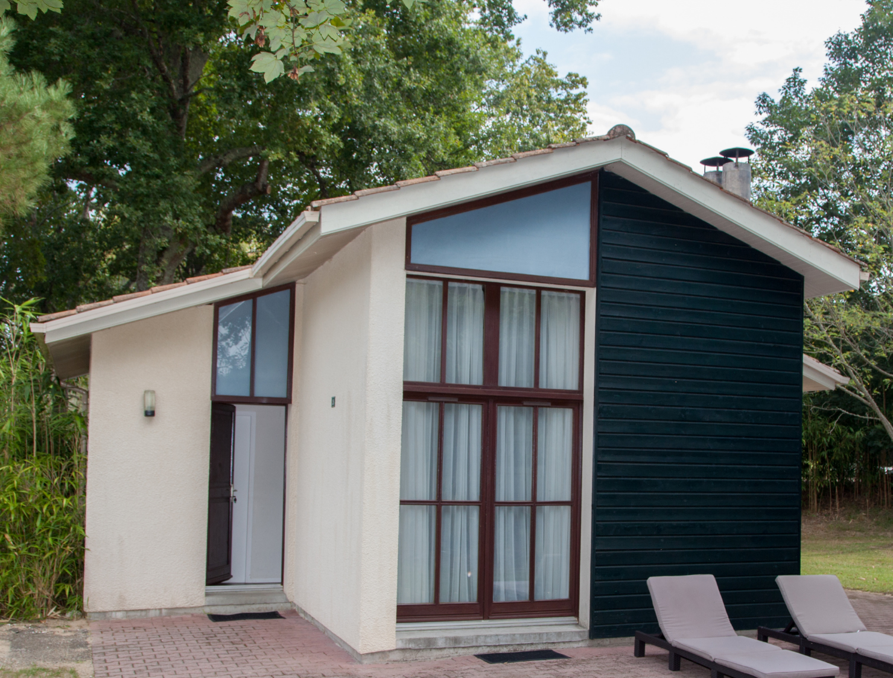
Michigan Zoning Enabling Act
Applies to all municipalities.
HB 5581
Section 205(e) – “A zoning ordinance must not impose a minimum area requirement of greater than 500 square feet for a dwelling.”

Slide 9
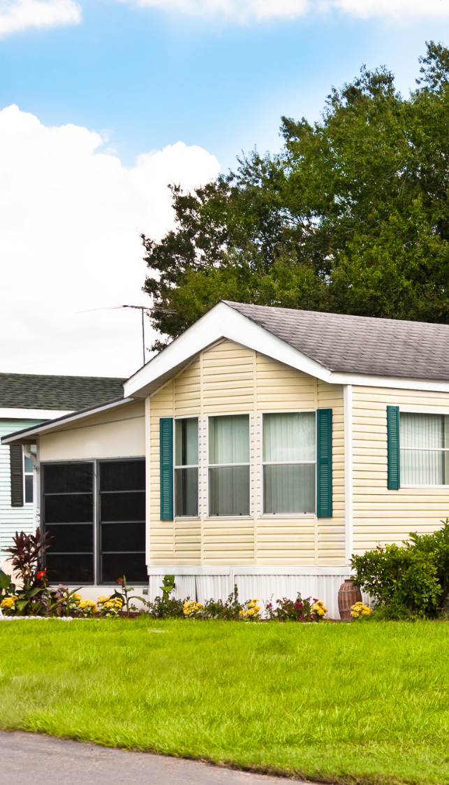
Michigan Zoning Enabling Act
Applies to all municipalities.
HB 5582
Section 205(6) – “A zoning ordinance must not:
require the provision of more than 1 parking space, including guest parking, per dwelling unit for a multifamily residential use of the property; or,
exclude from any residential zone a mobile home as defined in section 2 of the mobile home commission act, 1987 PA 96, MCL 125.2302, including, but not limited to, implicit exclusion based on restriction regarding aesthetics or construction material that are not necessary for public safety or are primarily intended to exclude mobile homes from a residential zone.”

Slide 10
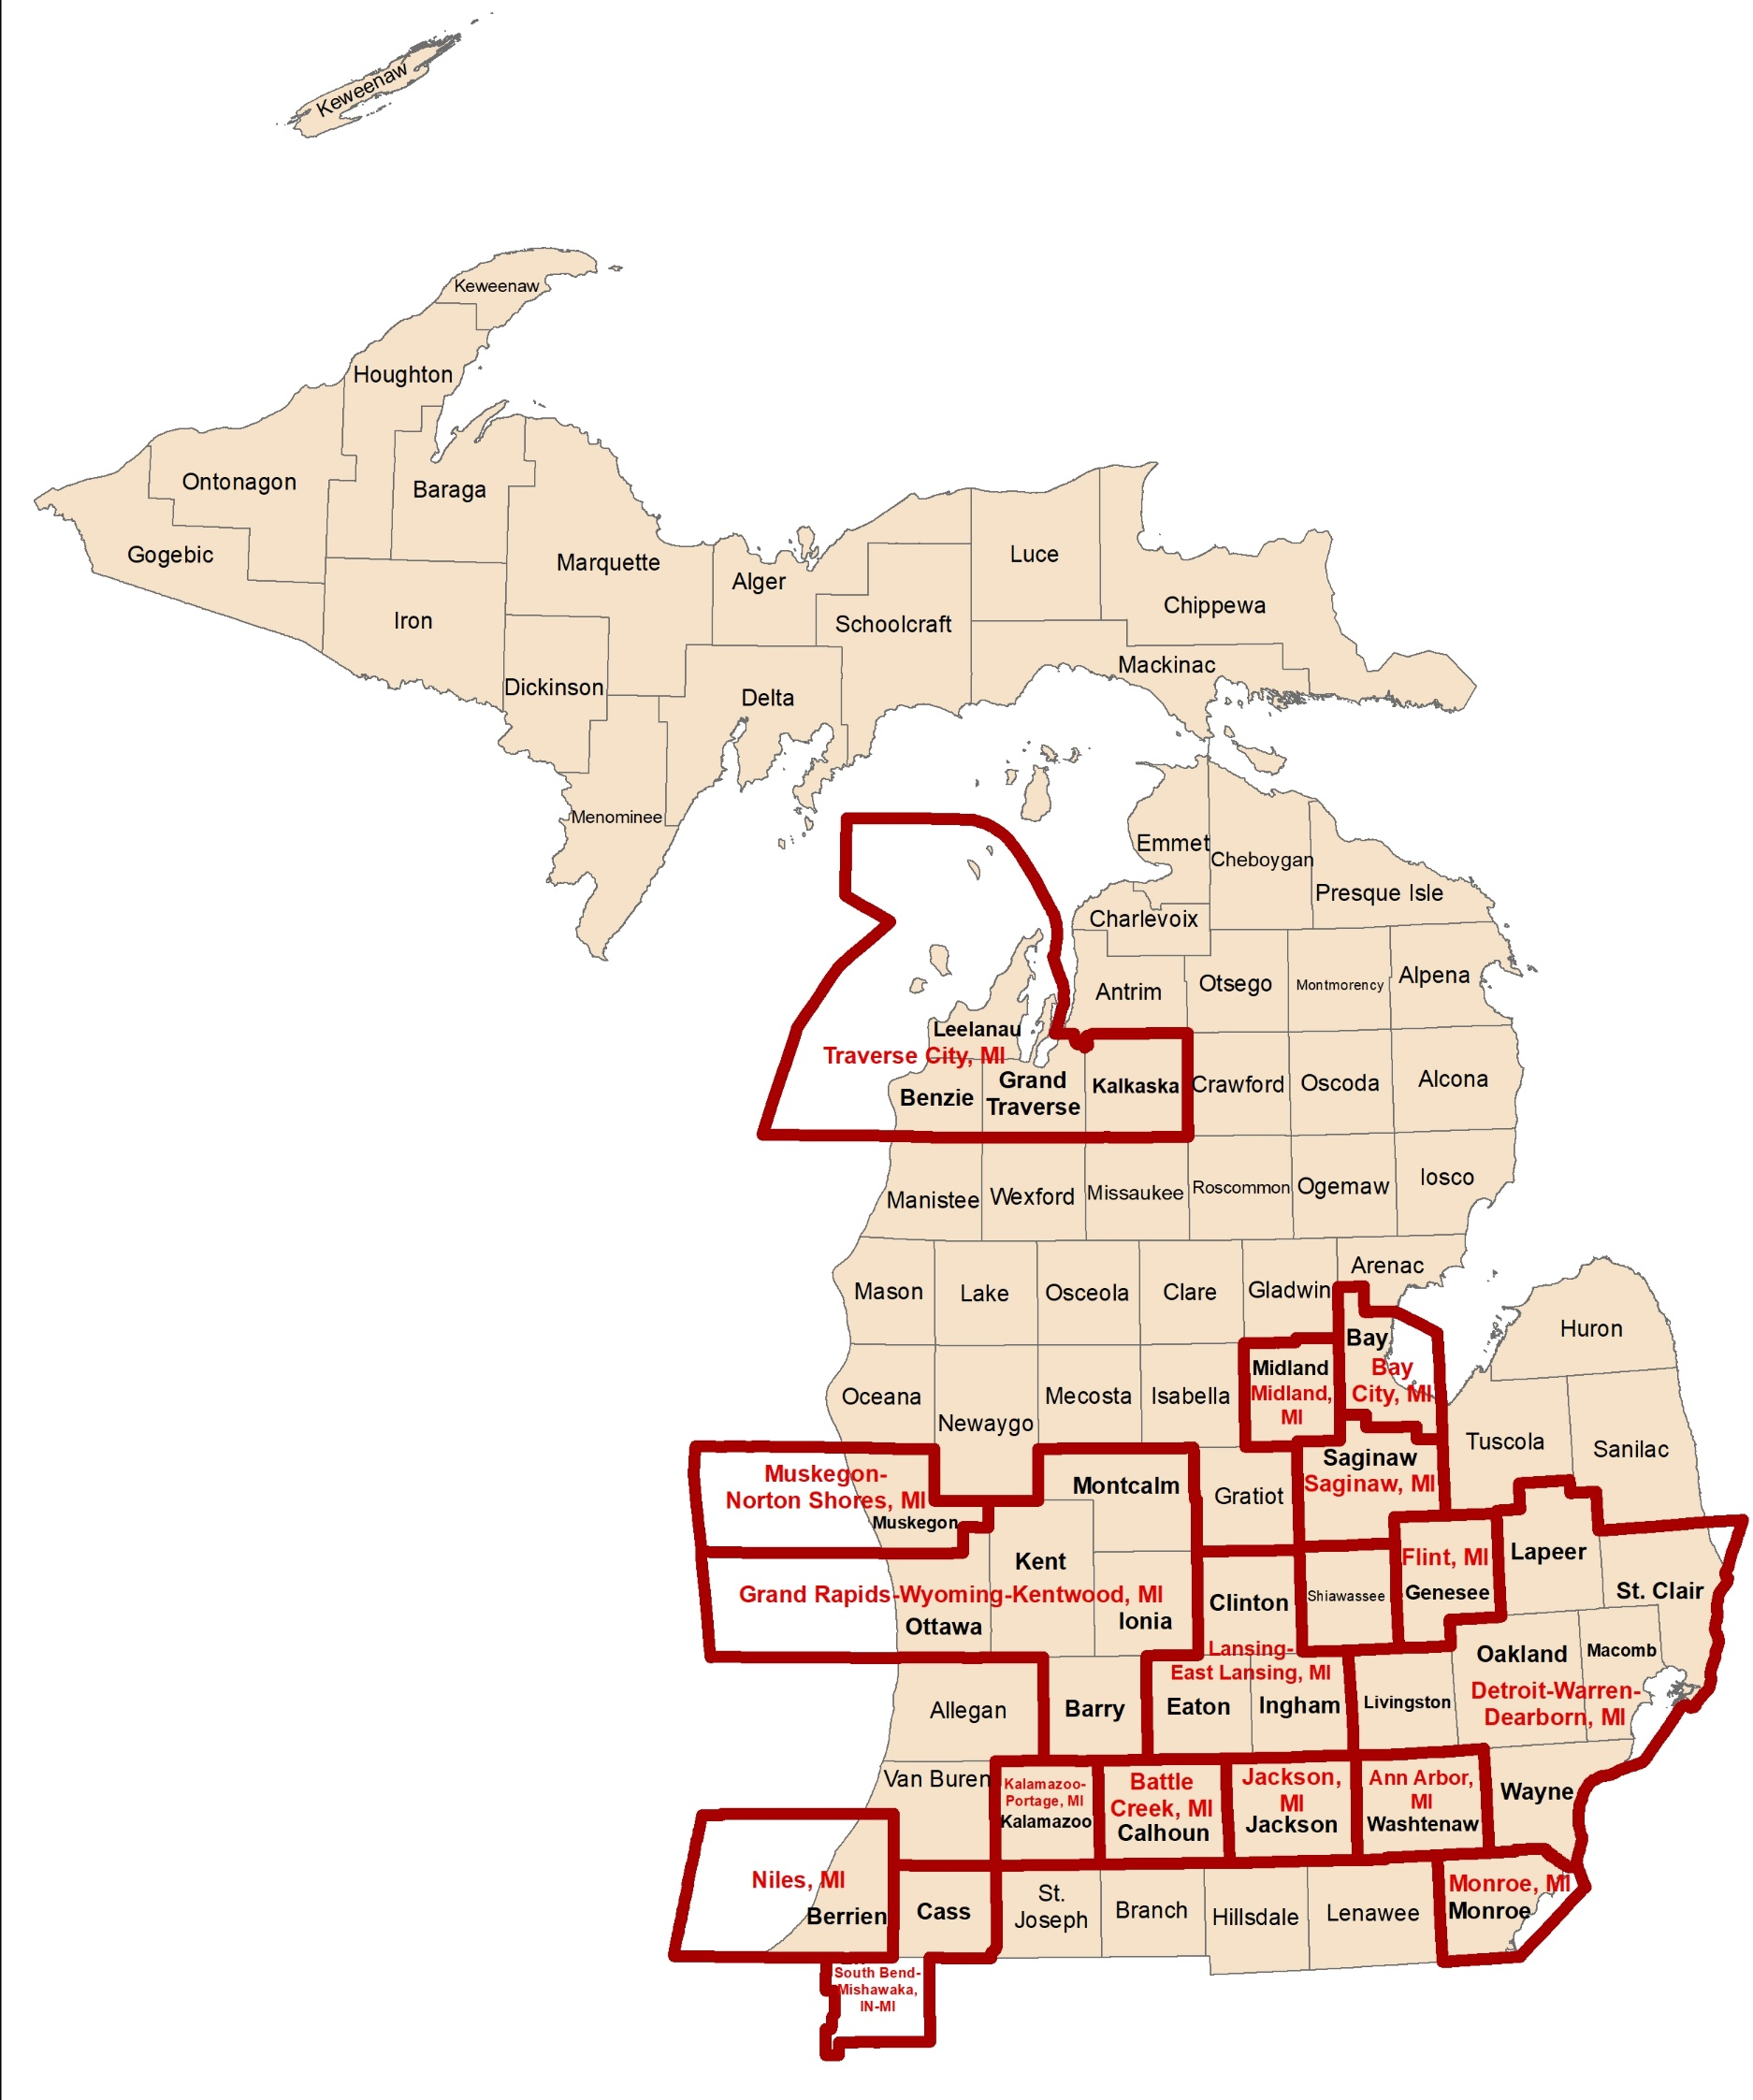
Michigan Zoning Enabling Act
Applies to local units of government located in whole or in part in a Metropolitan Statistical Area (MSA) and those adjacent to a MSA.
HB 5583
Section 205(c) – “A zoning ordinance must not impose a minimum setback requirement for a dwelling or outbuilding of more than 15 feet from the front property line or 5 feet from the rear or a side property line if the local unit of government is located in whole or part within a metropolitan statistical are or is located adjacent to a metropolitan statistical area…may impose a setback requirement of not more than 25 feet from any of the following: (a) a wetland; (b) an inland lake or stream; (c) the ordinary high water mark of the Great Lakes.”

Slide 11
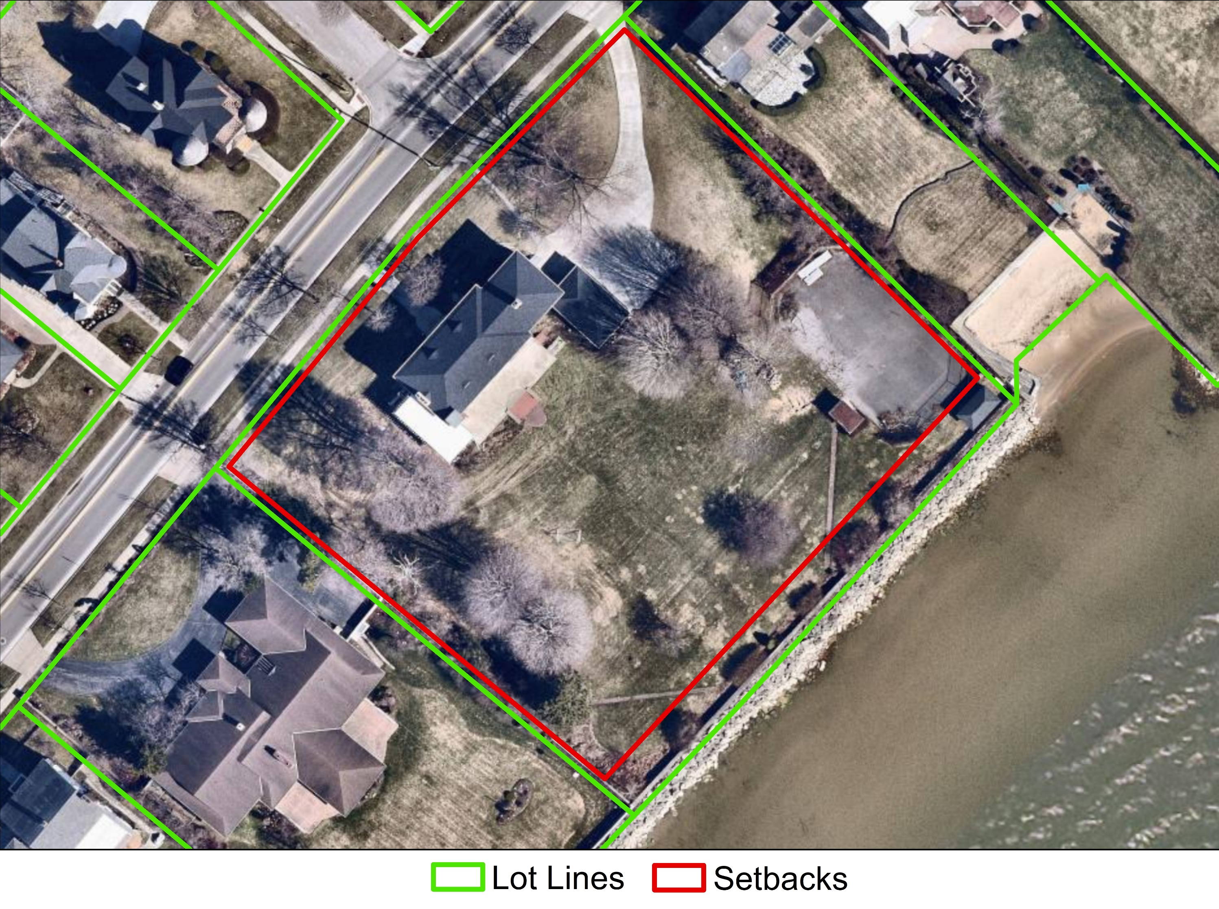
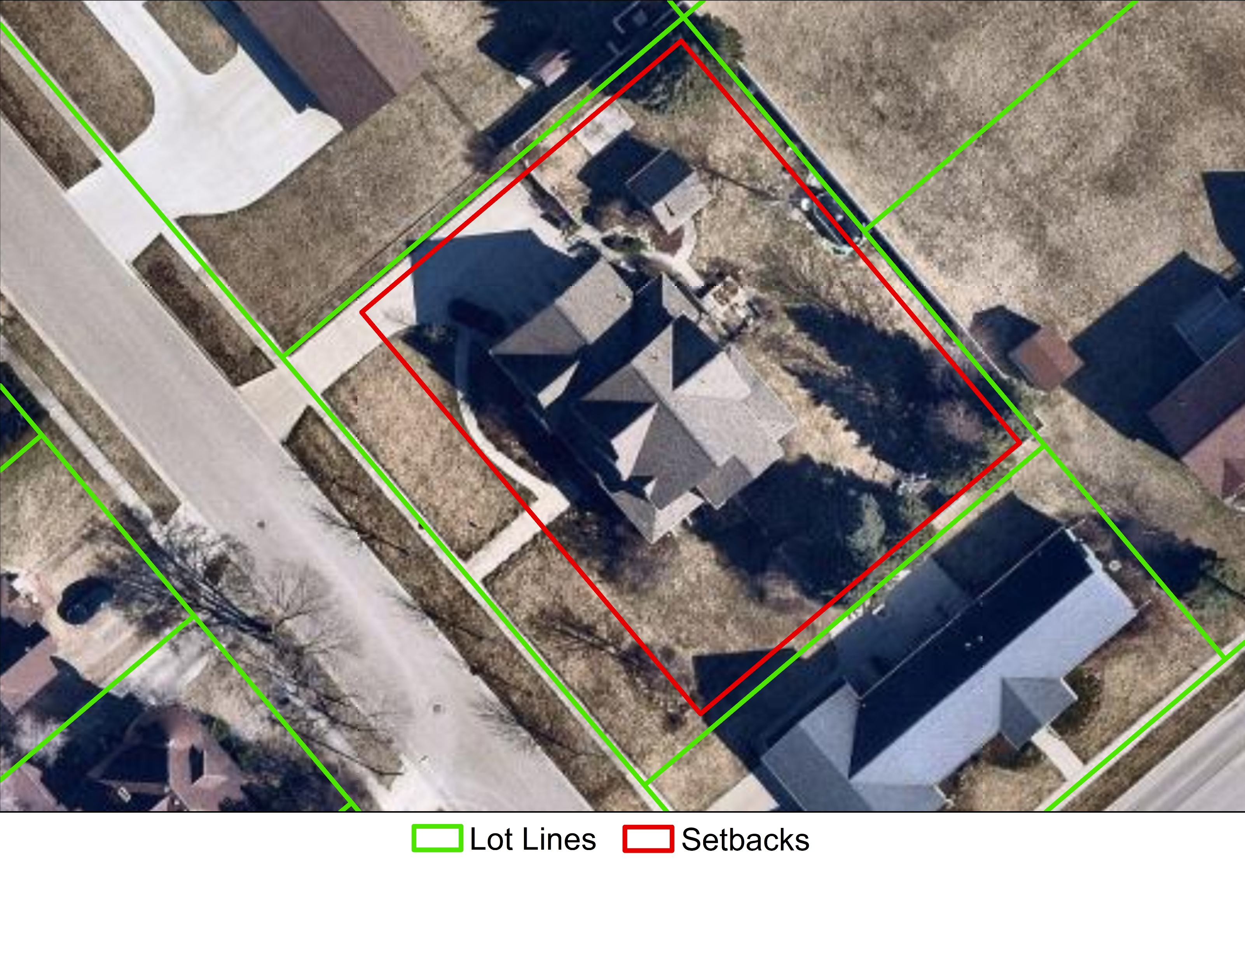

Slide 12
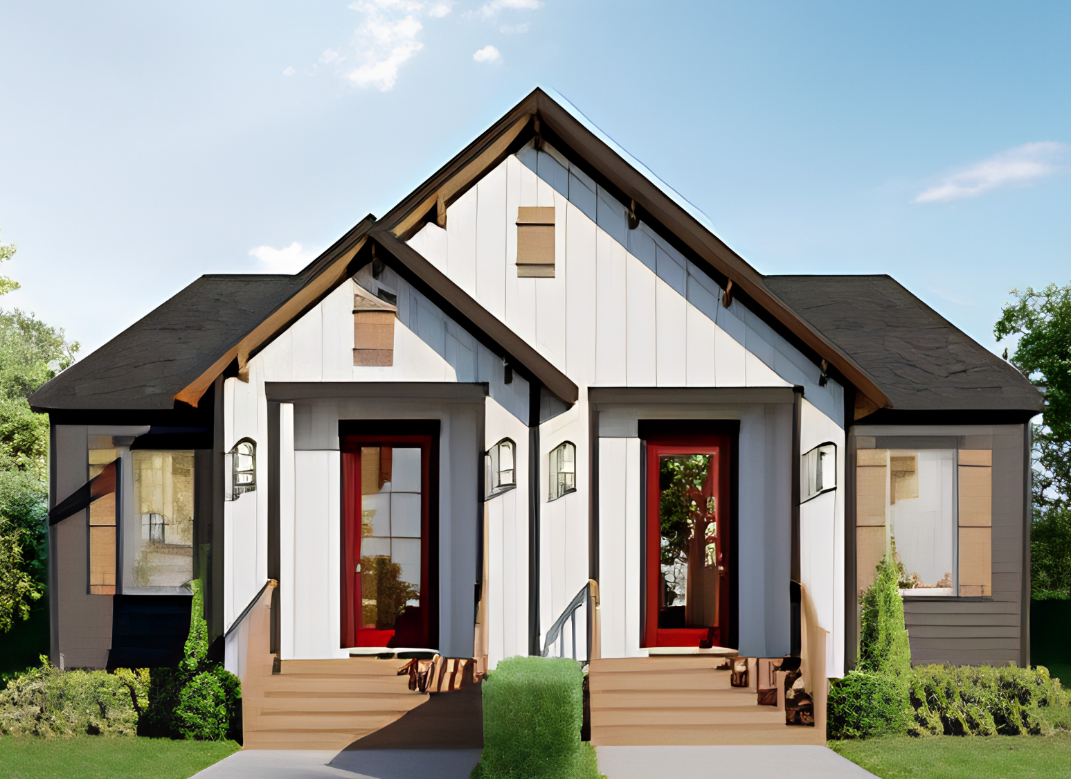
Michigan Zoning Enabling Act
Applies to all municipalities.
HB 5584
Section 102(j) – “Duplex means a single building sited on a single parcel or lot that contains 2 separate residential units, whether the separation is horizontal or vertical.”

Slide 13
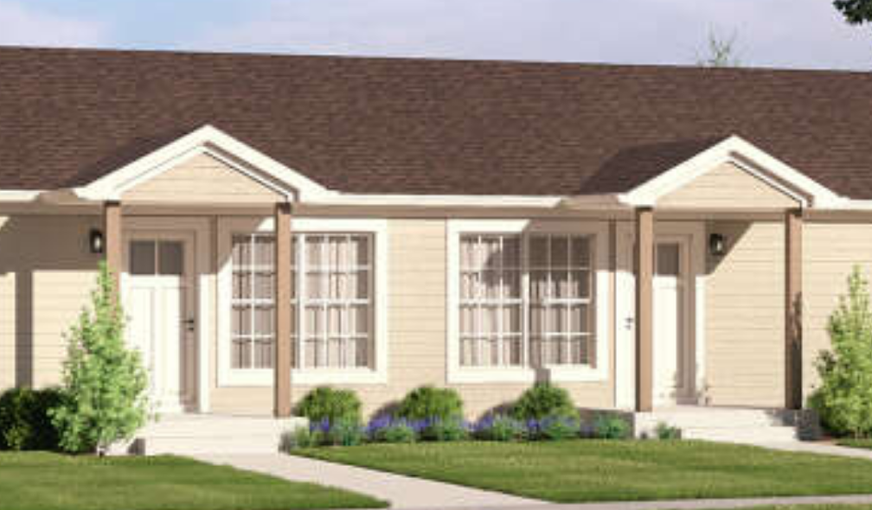
Michigan Zoning Enabling Act
Applies to all municipalities.
HB 5584
Continued
Section 517(1) – “A duplex is a permitted use in any district in which a single-family residence is a permitted use, and the duplex is subject to the same permitting procedures as single-family residence.”
Section 517(2) – “A local unit of government shall not impose requirements related to the bulk or size of building that prevent the construction of duplexes with at least 1,000 square feet of habitable floor space per residential unit.”
Section 517(3)(a) - “A zoning ordinance must not require the provision of more than 1 parking space, including guest parking, per residential unit for a duplex.”; (3)(b) “Impose design, aesthetic, height, placement, or any other requirements on a duplex that are more restrictive than those applied to a single-family residence.”

Slide 14
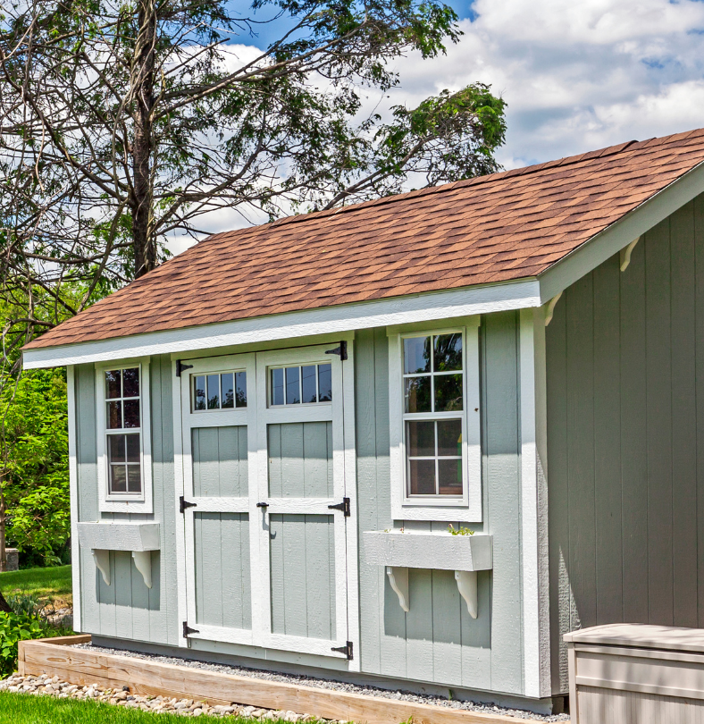
Michigan Zoning Enabling Act
Applies to all municipalities.
HB 5585
Section 102(a) – “Accessory dwelling unit, or ADU, means a secondary dwelling unit, whether constructed on-site or off-site, that is incidental to another dwelling unit located on the same parcel of real property.”

Slide 15

Section 516(1) – “If all of the following apply, an accessory dwelling unit is a permitted use of property under a zoning ordinance and is not subject to approval or disapproval under zoning ordinance, except on nondiscretionary basis by administrative staff and without a public hearing:
the ADU is not greater than 800 square feet or 75% of the gross square footage of the dwelling to which the ADU is incidental, whichever is less;
the ADU and the dwelling to which the ADU is incidental are set back at least 5 feet from the rear and side property lines;
the ADU is located in a district in which residential use is a permitted use, whether or not a residential use other than an ADU is subject to a special land use or conditional use permit;
the ADU is (i) constructed within what is otherwise a single-family dwelling unit that is existing or under construction, or (ii) attached to or sharing a wall with a single-family dwelling unit that is existing or under construction, or (iii) as a separate structure on a parcel with a single-family dwelling unit that is existing or under construction.”
Michigan Zoning Enabling Act
Applies to all municipalities.
HB 5585
Continued

Slide 16
Section 516(3) –
In any zoning district with a maximum dwelling unit density, expressed in total number of dwelling units in the district, total number of dwelling units per unit of land area, or otherwise, an ADU must be excluded from the calculation of the dwelling unit density.
An accessory dwelling unit is not subject to a parking space requirement or owner occupancy requirement under a zoning ordinance.
A local unit of government may retroactively approve an accessory dwelling unit that was built without the approval of the local unit of government.
A zoning ordinance must not do either of the following:
Impose design, aesthetic, height, or placement requirements on an accessory dwelling unit that are more restrictive than those applied to the dwelling unit to which the ADU is incidental.
Restrict the use of an accessory dwelling unit to occupancy by the owner of the dwelling to which the ADU is incidental.
Restrict an accessory dwelling unit from having a basement or require an ADU to have a basement.
Michigan Zoning Enabling Act
Applies to all municipalities.
HB 5585
Continued

